Slide 1
Advanced Data Analysis 367-2-5461
Opher Donchin

Slide 2
Topics
Homework
Measurement error
Missing data

Slide 3
Topics
Homework
Measurement error
Missing data

Slide 4
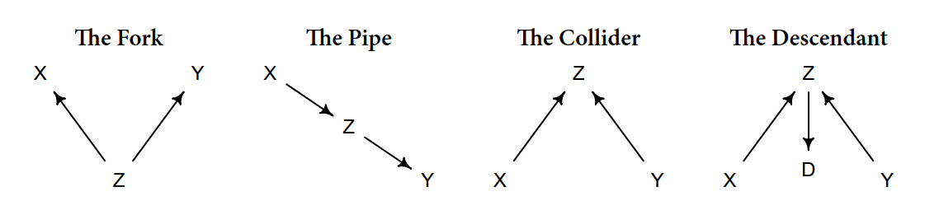
Correlation caused by a confounder

Slide 5
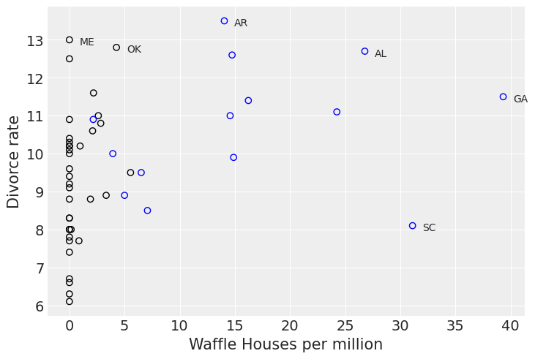
The Waffle Divorce data
Waffle houses cause divorce!

Slide 6
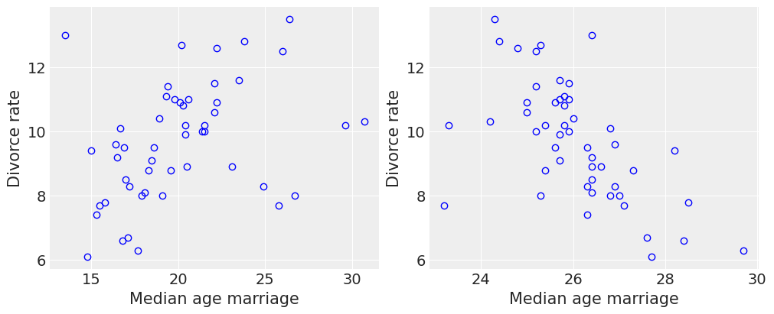
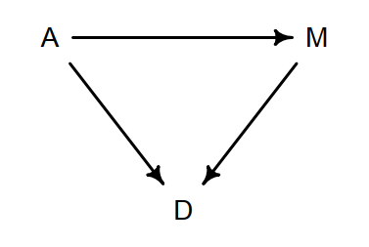
Maybe less spurious
Used in Ch. 5 to show how to separate the direct effect ($A→D$) from the indirect effect ($A→M⟶D$)
Marriage rate

Slide 7
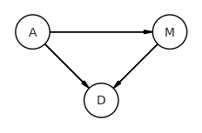
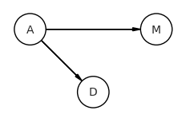
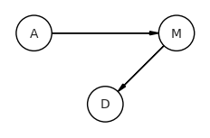
Three DAGs
Which of these causal models explains the correlations

Slide 8
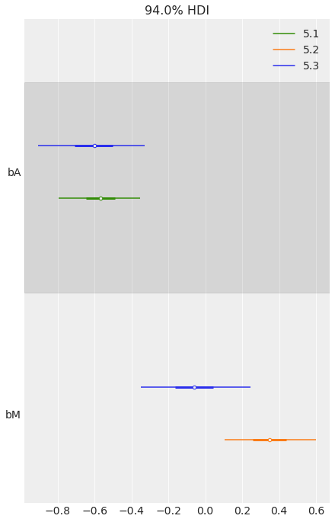
Fit linear regressions
Information about marriage rate doesn’t change the effect of age of marriage
Adding information about age makes marriage age superfluous

Slide 9
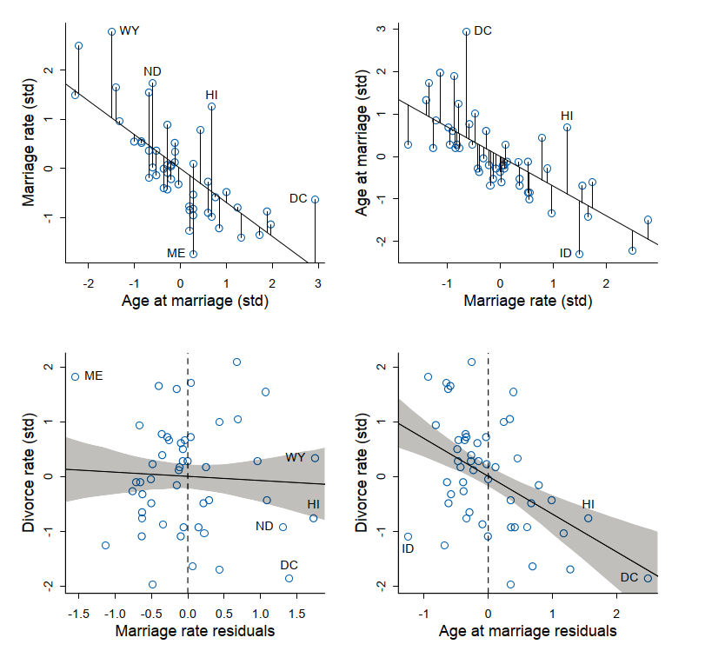
Regressing on residuals
A similar idea:
If I remove age at marriage from marriage rate
There is no longer any relationship to divorce rate
If I remove marriage rate from age at marriage
Age at marriage still strongly related to divorce rate

Slide 10
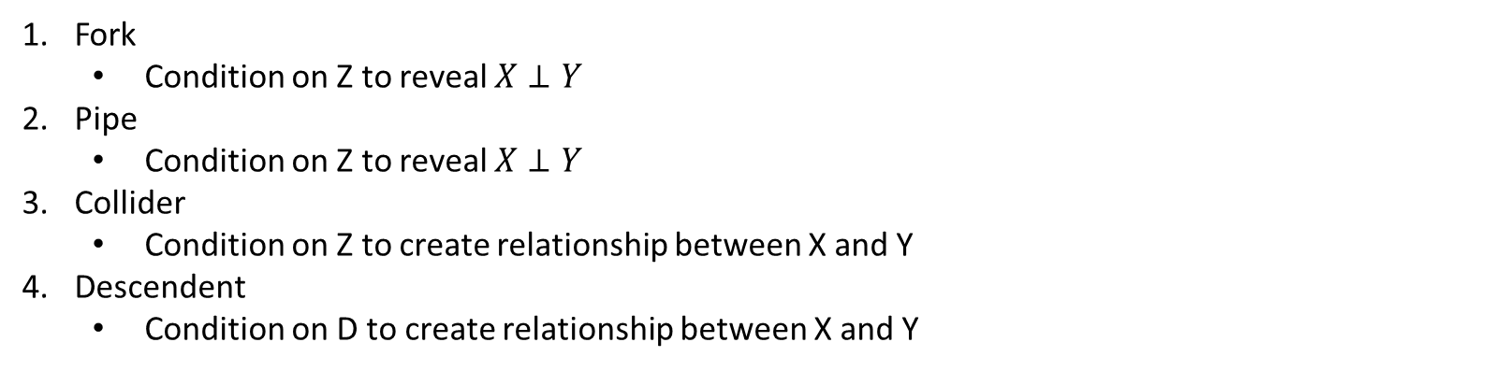
The 4 elemental confounds
Each must be dealt with differently
Fork
Condition on Z to reveal $X⊥Y$
Pipe
Condition on Z to reveal $X⊥Y$
Collider
Condition on Z to create relationship between X and Y
Descendent
Condition on D to create relationship between X and Y

Slide 11
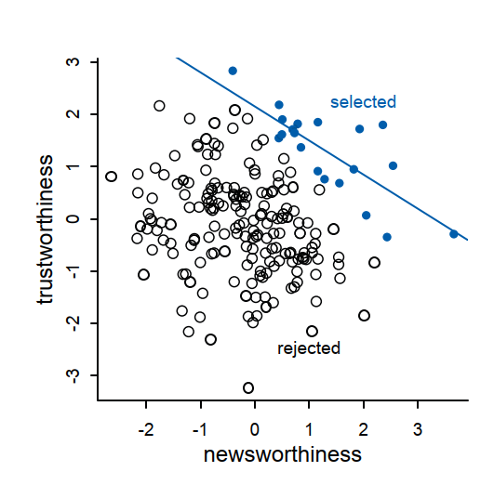
Collider
A good journal selects for both
Trustworthiness
Newsworthiness
There is no correlation in reality
There is in the selected papers
T
N
S

Slide 12
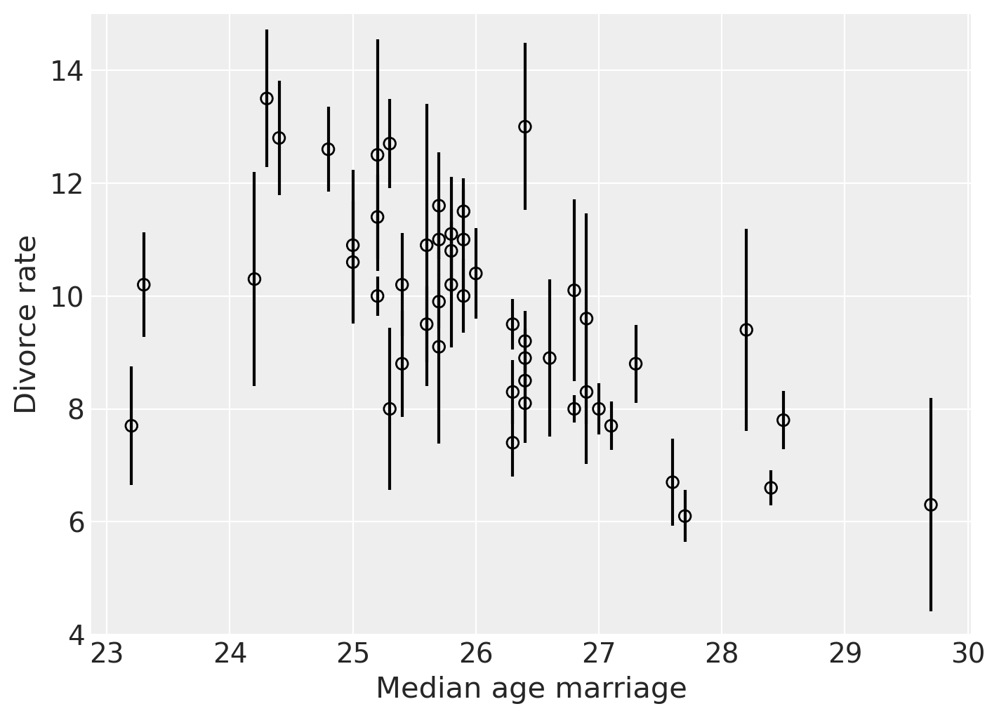
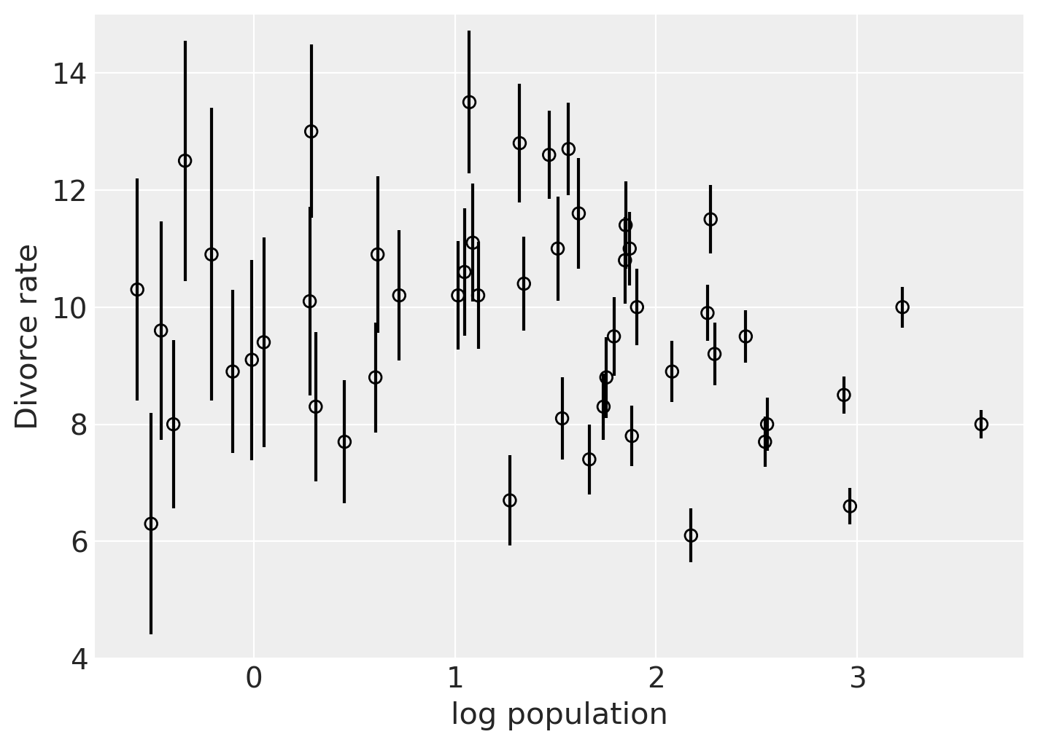
Measurement error
Often what we measure is not what’s there

Slide 13
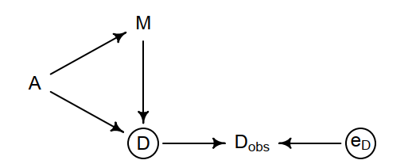
A model that includes measurement error
Circles show unobserved variables
A measurement error model
Our naïve model

Slide 14
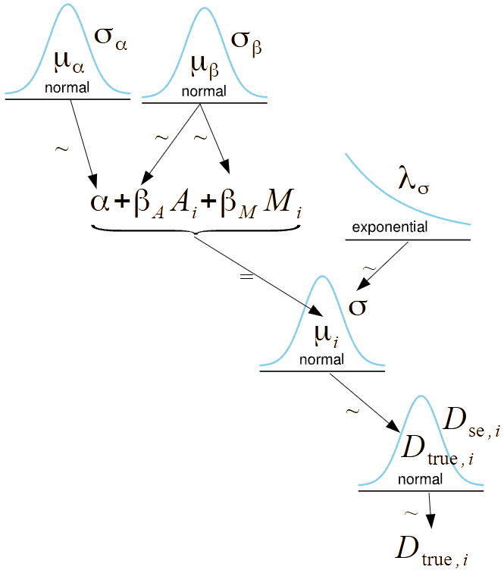
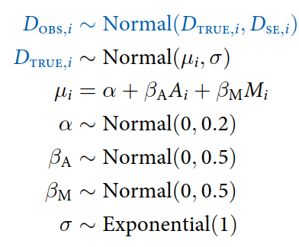
The model
Just like a regular regression model with an extra layer

Slide 15
In PyMC
with pm.Model() as m15_1:
sigma = pm.Exponential("sigma", 1)
bM = pm.Normal("bM", 0, 0.5)
bA = pm.Normal("bA", 0, 0.5)
a = pm.Normal("a", 0, 0.2)
mu = a + bA * A + bM * M # linear model to assess A -> D
D_true = pm.Normal("D_true", mu, sigma, shape=N) # distribution for true values
D = pm.Normal("D_obs", D_true, D_sd, observed=D_obs) # distribution for observed values

Slide 16
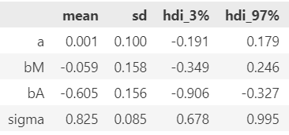
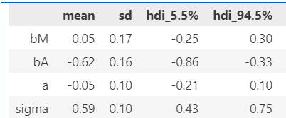
Small changes in parameter values
The book says bA is -1 in the naïve model
Not sure why
Naïve model
Measurement error model

Slide 17
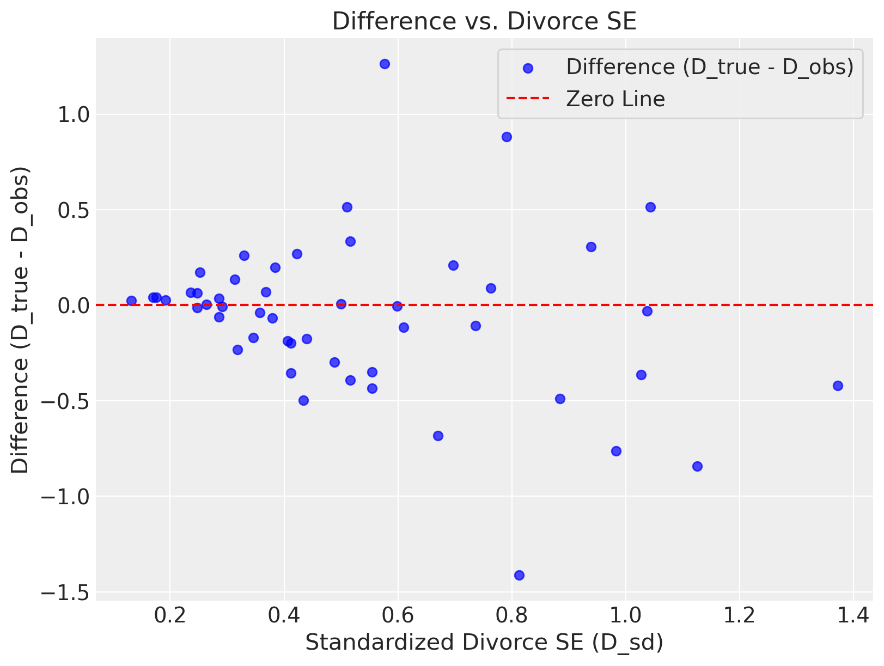
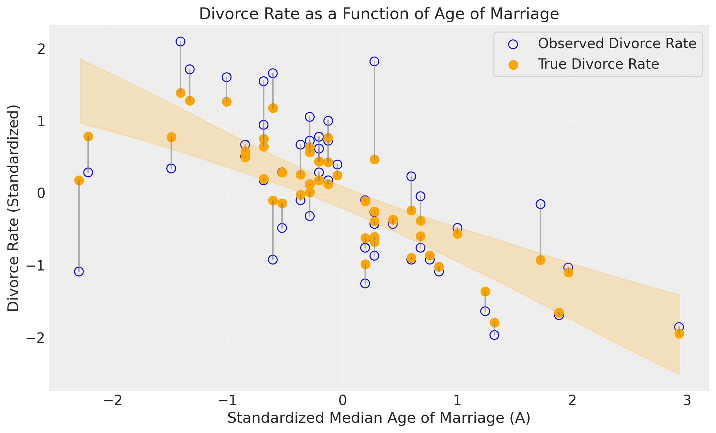
Effect of measurement error model

Slide 18
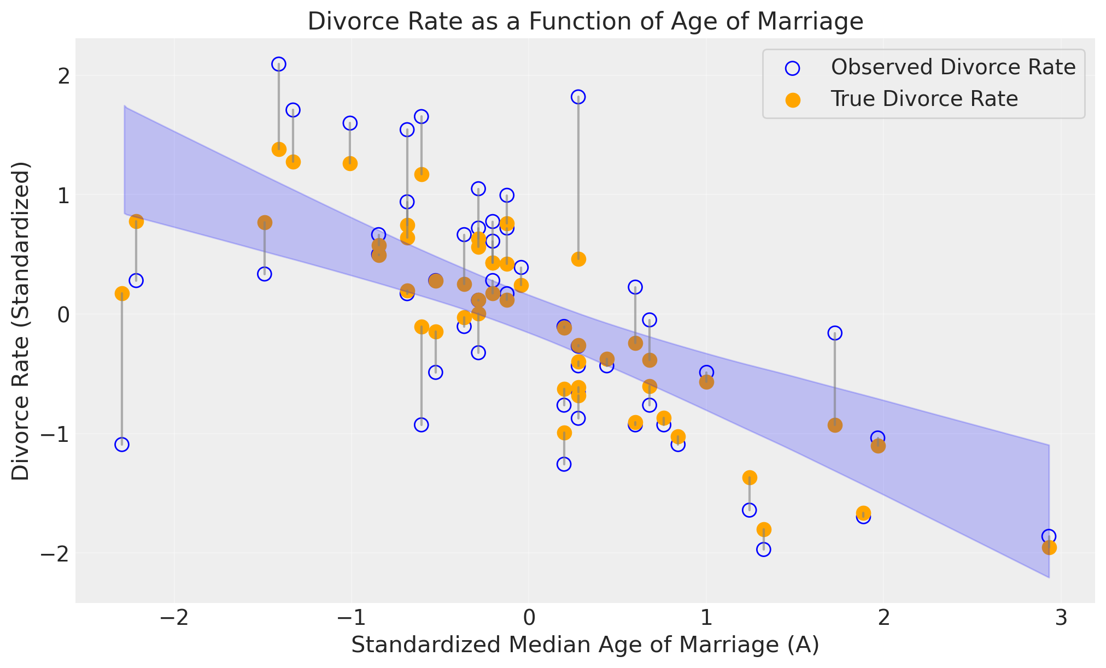
Comparison of two regression models
Different points are weighted
Naïve model
Measurement error model

Slide 19
Measurement error in both variables

Slide 20
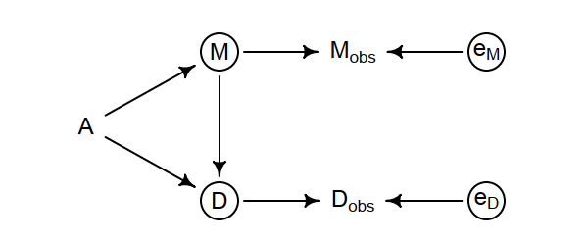
A model that includes multiple measurement errors
Circles show unobserved variables

Slide 21
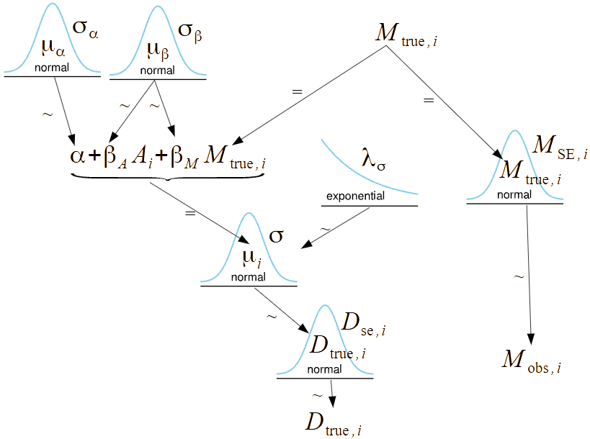
The double error model
One measurement error
Double measurement error

Slide 22
In PyMC
with pm.Model() as m15_2:
sigma = pm.Exponential("sigma", 1)
bM = pm.Normal("bM", 0, 0.5)
bA = pm.Normal("bA", 0, 0.5)
a = pm.Normal("a", 0, 0.2)
M_true = pm.Normal("M_true", 0, 1, shape=N) # distribution for true M values
mu = a + bA * A + bM * M_true # linear model
D_true = pm.Normal("D_true", mu, sigma, shape=N) # distribution for true D values
D = pm.Normal("D_obs", D_true, D_sd, observed=D_obs) # distribution for observed D values
M = pm.Normal("M_obs", M_true, M_sd, observed=M_obs) # distribution for observed M values

Slide 23
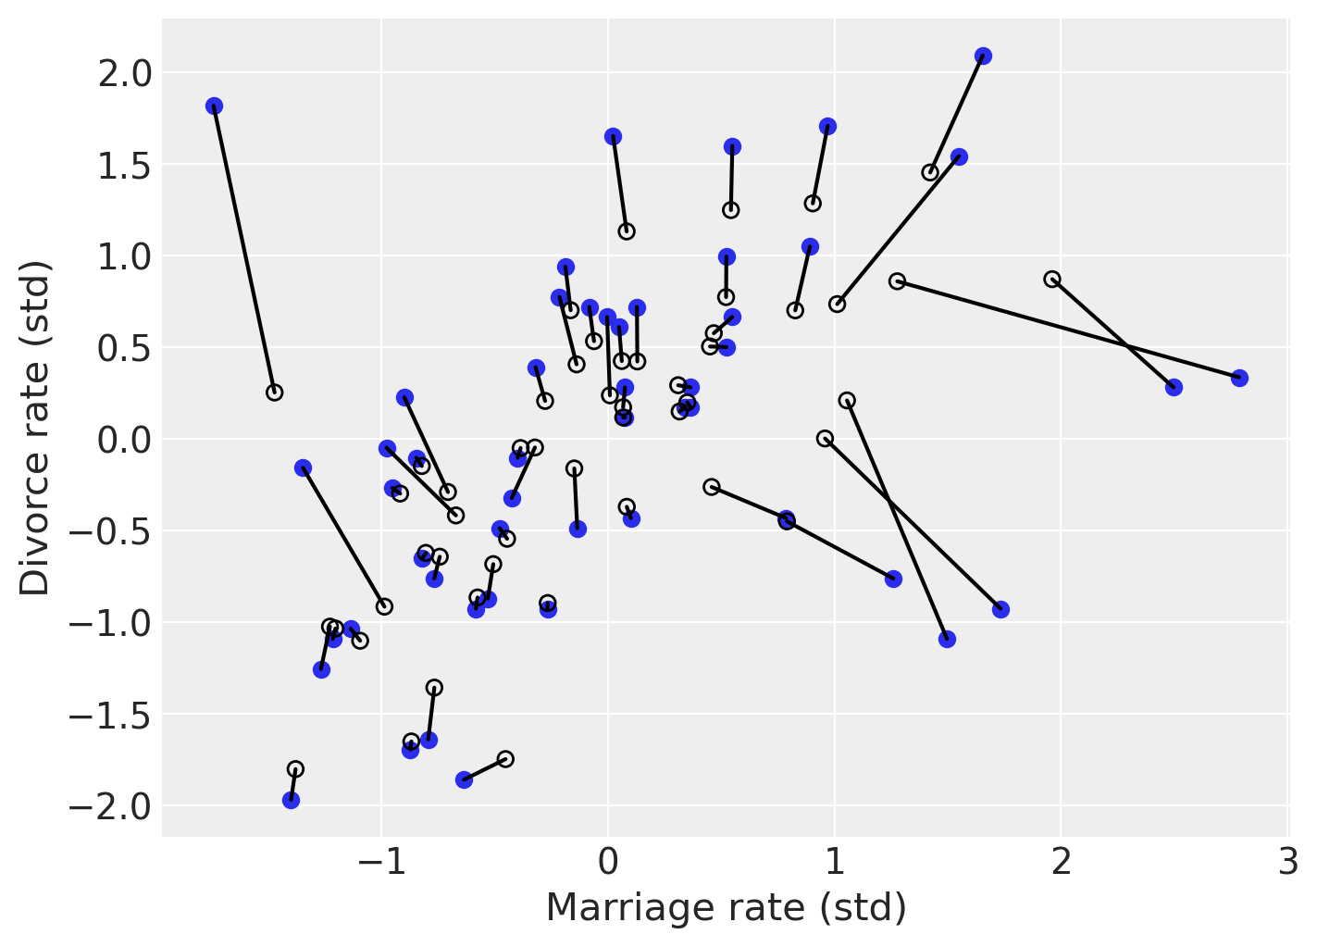
The effect of adding measurement error

Slide 24
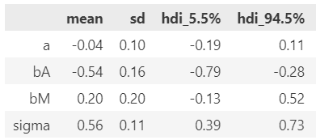
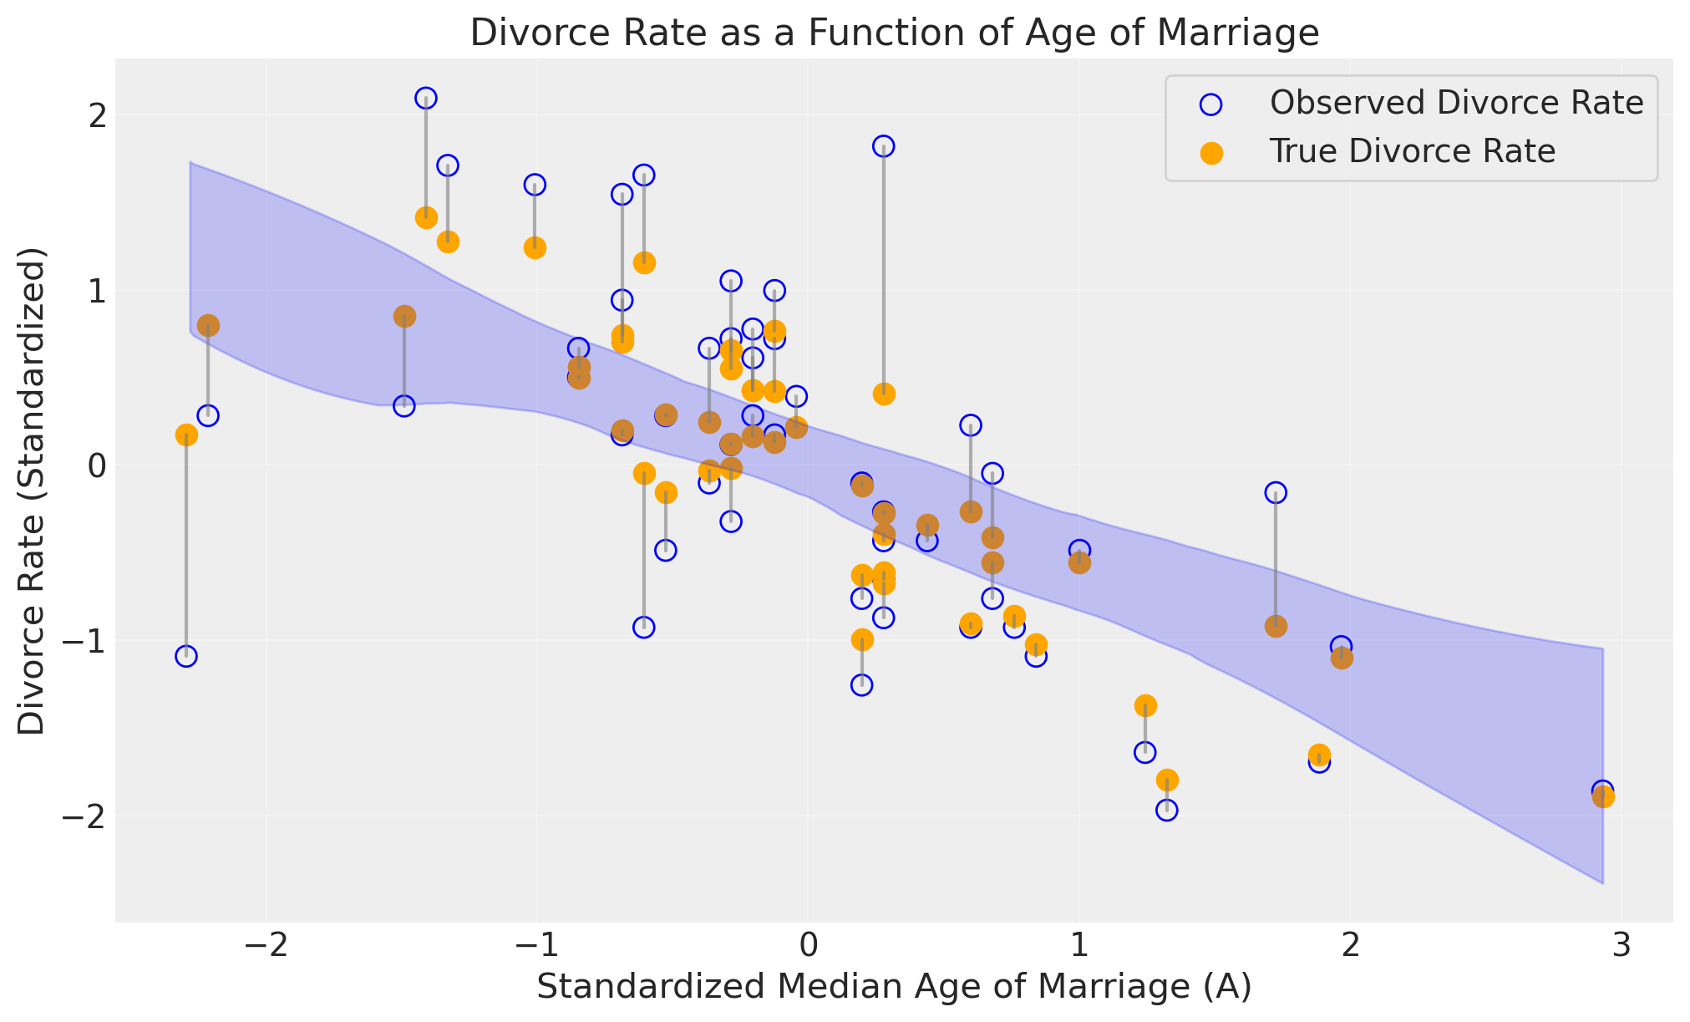
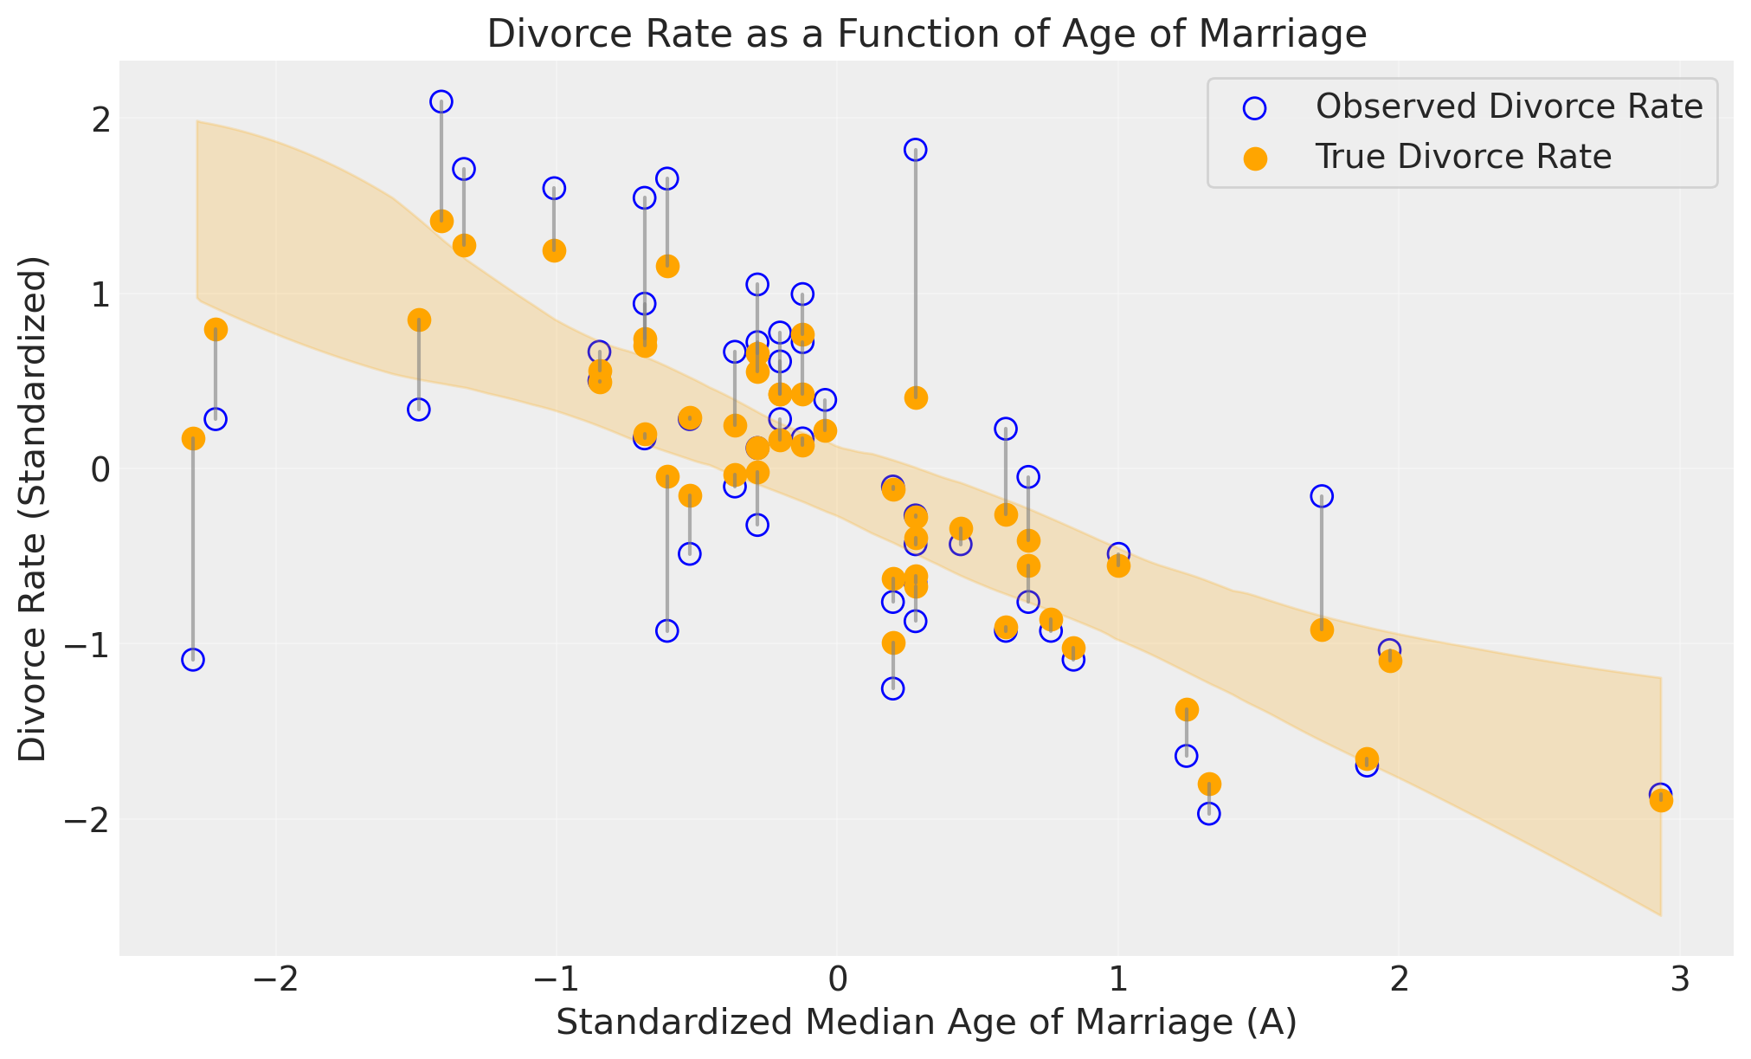
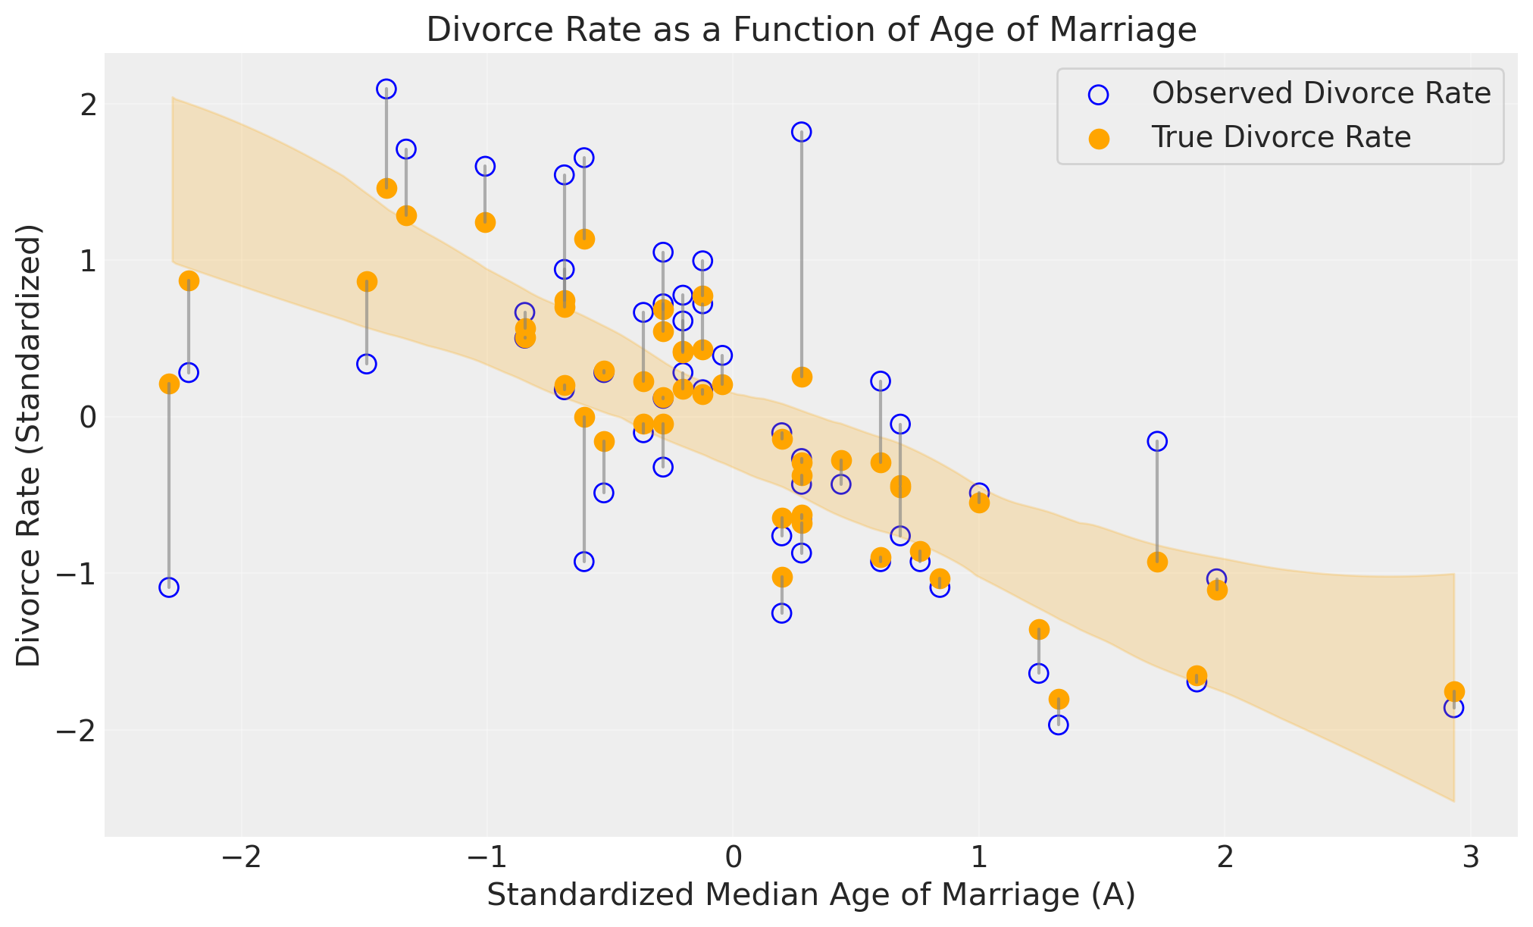
Comparing all three models
Naïve model
Measurement error model
Double error model

Slide 25
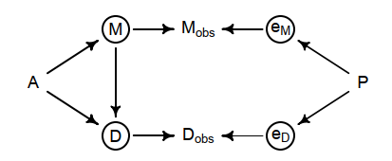
Correlated errors
For instance
Poor rural reporting might decrease counts of both M and D
Spuriously drive relationship of M and D

Slide 26
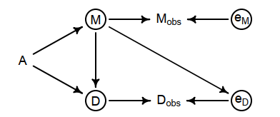
Error influenced by variable
For instance
Fewer marriages leads to uncertainty in divorce rate leading to undercounting
Spuriously drive relationship of M and D

Slide 27
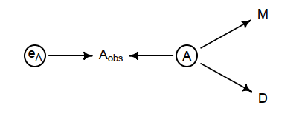
Hidden fork
M measured accurately
A seems accurate but is noisy
M will appear related to D
M and D have information about A
That is stronger than Aobs

Slide 28
Bottom line
Understand what you are measuring
Don’t automatically assume measurement errors are independent
Do build models

Slide 29
Topics
Homework
Measurement error
Missing data
Missing data models
Using other predictors in imputation
Marginalizing

Slide 30
Missing data
Data may be missing for a reason
The reason can matter
Build a model

Slide 31
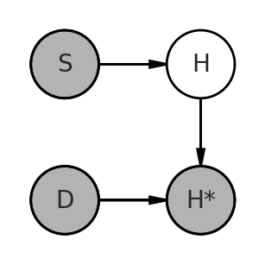
Toy example
Dogs eat homework
N = 1000 # Number of students
S = rng.normal(size=N) # How much each student studies
H = rng.binomial(
n=10, p=invlogit(2 + S), size=N
) # Homework grade affected by studying
H = np.array(H, dtype=float)
D = rng.integers(0, 2, size=N) # Random binary values (0 or 1) for dogs
Hm = H.copy() # Copy H to Hm
Hm[D == 1] = np.nan

Slide 32
Automatic imputation
Used in
Stan
PyMC3
Not used in
PyMC
Implicitly create random variables
One for each missing data
Assign them a distribution

Slide 33
Explicit imputation
Model of how studying affects grade
Explicitly create random variables
Assign them a distribution
Remove them from the data
Combine for likelihood
bS = pm.Normal("bS", 0, 0.5)
a = pm.Normal("a", 0, 1)
# Predictive probabilities
p = pm.invlogit(a + bS * S)
Coordinates to handle missing data
coords = {
"data": range(N),
"observed": np.where(~np.isnan(Ho))[0], # Indices of non-NaN values
"unobserved": np.where(np.isnan(Ho))[0], # Indices of NaN values
}
Distribution for missing data, Data for existing data
Hi_missing = pm.Binomial("Hi_missing", n=10, p=p[coords["unobserved"]], dims="unobserved")
H_observed = pm.Data("H_observed", Ho[~np.isnan(Ho)], dims="observed")
Combined likelihood
logp_observed = pm.math.sum(pm.logp(pm.Binomial.dist(n=10, p=p[coords["observed"]]), H_observed))
logp_missing = pm.math.sum(pm.logp(pm.Binomial.dist(n=10, p=p[coords["unobserved"]]), Hi_missing))
pm.Potential("logp", logp_observed + logp_missing)

Slide 34
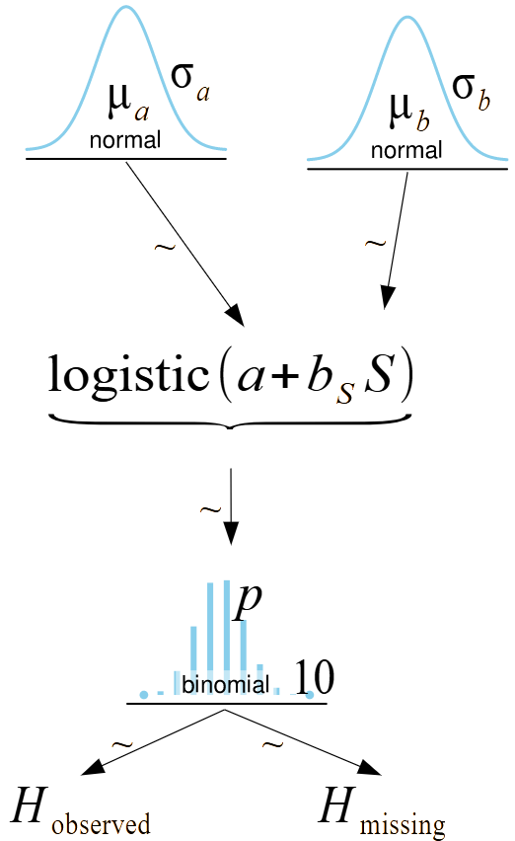
The missing data model
PyMC can’t have “observed” tensors
So we can fake it
Potential allows hacking the model
Combined likelihood
logp_observed = pm.math.sum(pm.logp(pm.Binomial.dist(n=10, p=p[coords["observed"]]), H_observed))
logp_missing = pm.math.sum(pm.logp(pm.Binomial.dist(n=10, p=p[coords["unobserved"]]), Hi_missing))
pm.Potential("logp", logp_observed + logp_missing)

Slide 35
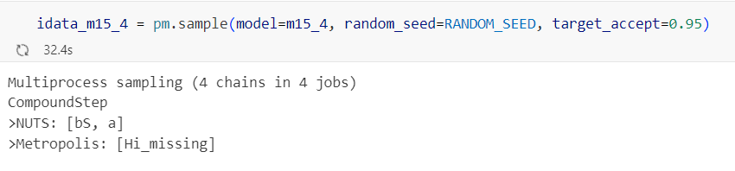
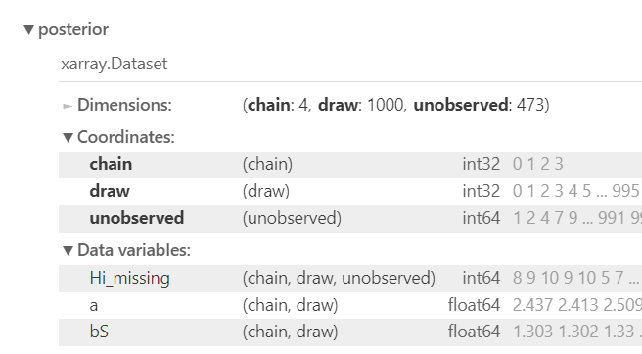
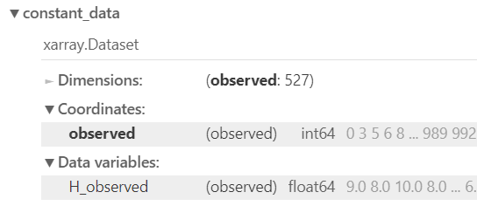
What does this give us?
Sampled parameters and missing data

Slide 36
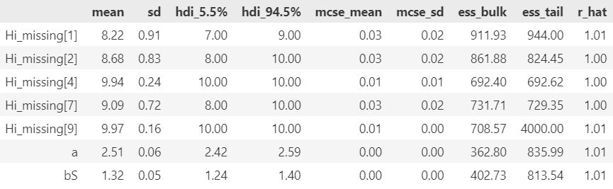
Sampling results
bS is overestimated
Number of samples is not large

Slide 37
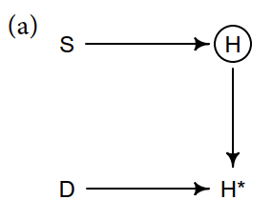
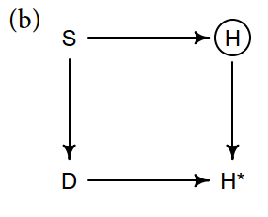
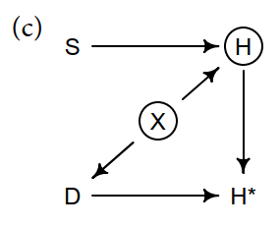
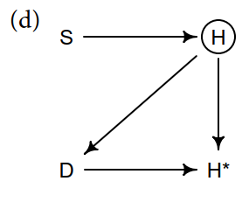
Why is the important?
We might have the wrong model!
Student behavior influences which dogs eat homework
Dogs eat homework randomly
An unmeasured factor affects both homework and dogs
The quality of the homework affects the dogs

Slide 38

Noisy homes
N = 1000 # Number of students
X = rng.normal(size=N) # Noise of house (unobserved)
S = rng.normal(size=N) # How much each student studies
H = rng.binomial(
n=10, p=invlogit(2 + S - 2 * X), size=N
) # Homework grade affected by study and noise
D = X > 1 # Dogs eat homework in noisy houses
with pm.Model() as m15_3:
bS = pm.Normal("bS", 0, 0.5)
a = pm.Normal("a", 0, 1)
p = pm.invlogit(a + bS * S[~D]) # Model includes study S but not noise X
Hi = pm.Binomial("Hi", n=10, p=p, observed=H[~D])

Slide 39
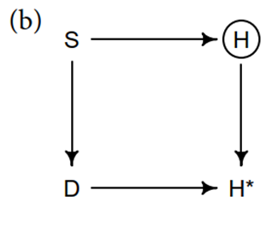

Inattentive students
N = 1000 # Number of students
S = rng.normal(size=N) # How much each student studies
H = rng.binomial(
n=10, p=invlogit(S), size=N
) # Homework grade affected by study and noise
D = S > 1 # Dogs eat homework in noisy houses

Slide 40
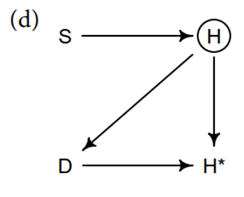

Dogs hate bad homework
N = 1000 # Number of students
S = rng.normal(size=N) # How much each student studies
H = rng.binomial(
n=10, p=invlogit(S), size=N
) # Homework grade affected by study and noise
D = H < -1 # Dogs eat bad homework

Slide 41
Topics
Homework
Measurement error
Missing data
Missing data models
Using other predictors in imputation
Marginalizing

Slide 42
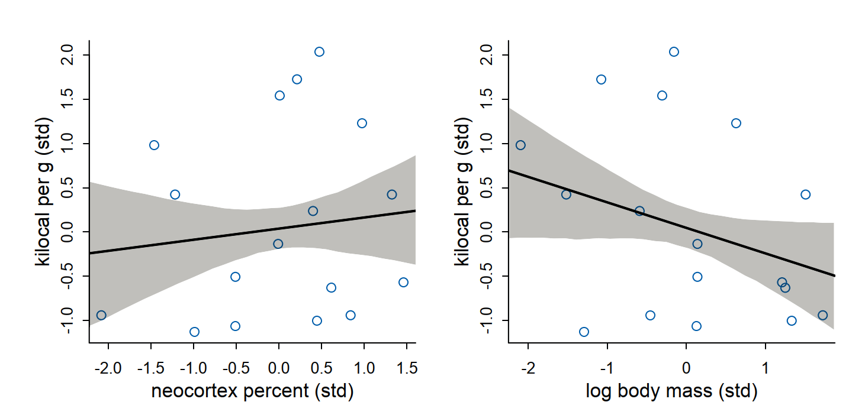
Do larger brains require more nutritious milk?
Used in Chapter 5
Multivariate regression
Two predictors cancel each other out
True values only when both included
Did complete case analysis
Univariate fits to data
with pm.Model() as m5_7:
sigma = pm.Exponential("sigma", 1)
bN = pm.Normal("bN", 0, 0.5)
bM = pm.Normal("bM", 0, 0.5)
a = pm.Normal("a", 0, 0.2)
mu = pm.Deterministic("mu", a + bN * shared_N + bM * shared_M)
K = pm.Normal("K", mu, sigma, observed=dcc["K"])

Slide 43
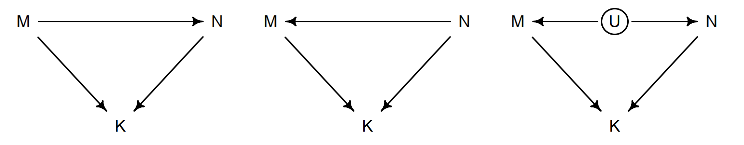
Complete case DAGs
These DAGs are “Markov equivalent”
Meaning the can’t be distinguished from the data

Slide 44
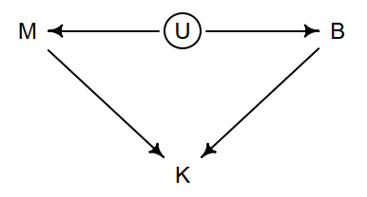
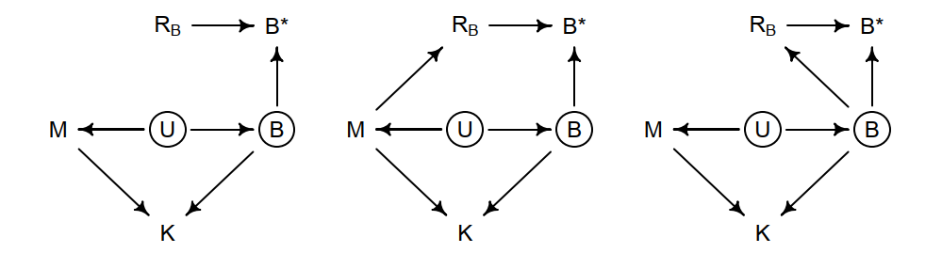
Missing data DAGs
Complete case DAG
Alternative missing data DAGs

Slide 45
Turn missing values into parameters
N (Neocortex) in chapter 5 became B (Brain) in chapter 15
Imputation is automatic in PyMC
with pm.Model() as m5_7:
sigma = pm.Exponential("sigma", 1)
bN = pm.Normal("bN", 0, 0.5)
bM = pm.Normal("bM", 0, 0.5)
a = pm.Normal("a", 0, 0.2)
mu = pm.Deterministic("mu", a + bN * shared_N + bM * shared_M)
K = pm.Normal("K", mu, sigma, observed=dcc["K"])
with pm.Model() as m15_5:
sigma_B = pm.Exponential("sigma_B", 1)
sigma = pm.Exponential("sigma", 1)
bM = pm.Normal("bM", 0, 0.5)
bB = pm.Normal("bB", 0, 0.5)
nu = pm.Normal("nu", 0, 0.5)
a = pm.Normal("a", 0, 0.5)
# PyMC automatically imputes missing values
Bi = pm.Normal("Bi", nu, sigma_B, observed=B)
mu = a + bB * Bi + bM * M
Ki = pm.Normal("Ki", mu, sigma, observed=K)

Slide 46
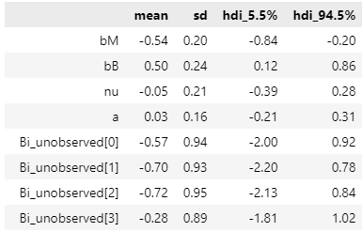
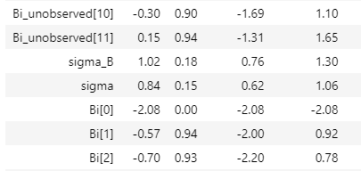
PyMC generates parameters for missing values
If there is no data, the posterior equals the prior

Slide 47
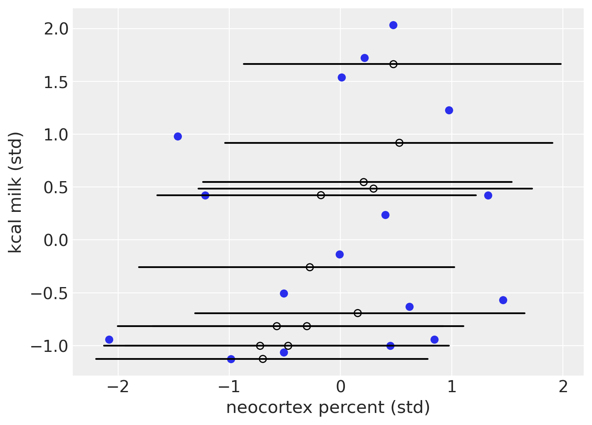

This model doesn’t impute in a smart way
Bi is imputed with mean nu and variance sigma_B
Bi = pm.Normal("Bi", nu, sigma_B, observed=B)

Slide 48
Allow correlation between predictors
Correlation replaces only missing values
MB_masked = np.ma.masked_invalid(np.stack([M, B]).T)
with pm.Model() as m15_7:
sigma = pm.Exponential("sigma", 1)
muM = pm.Normal("muM", 0, 0.5)
muB = pm.Normal("muB", 0, 0.5)
bM = pm.Normal("bM", 0, 0.5)
bB = pm.Normal("bB", 0, 0.5)
a = pm.Normal("a", 0, 0.5)
chol, _, _ = pm.LKJCholeskyCov(
"chol_cov", n=2, eta=2, sd_dist=pm.Exponential.dist(1), compute_corr=True
)
# M and B correlation
MB = pm.MvNormal("MB", mu=pt.stack([muM, muB]), chol=chol, observed=MB_masked)
mu = a + bB * MB[:, 1] + bM * M
Ki = pm.Normal("Ki", mu, sigma, observed=K)

Slide 49


Better imputation
Not hard to guess neocortex percent from body mass

Slide 50
Topics
Homework
Measurement error
Missing data
Missing data models
Using other predictors in imputation
Marginalizing

Slide 51
Discrete missing values
Hard to sample from
Can’t use HMC
So one parameter at a time
Difficult for Gibbs
Like all discrete latent variable models!

Slide 52


Do cats reduce bird song?
Bird song easy to measure
How do we know if there is a cat?

Slide 53
Create the data
N_houses = 100 # Number of houses to simulate
alpha = 5 # Average number of notes when cat is absent
beta = -3 # Difference in number of notes when cat is present
k_true = 0.5 # Probability of cat present
r = 0.2 # Probability of not knowing whether cat present/absent
cat_true = rng.binomial(n=1, p=k_true, size=N_houses)
notes = rng.poisson(lam=alpha + beta * cat_true, size=N_houses)
R_C = rng.binomial(n=1, p=r, size=N_houses)
cat = cat_true.copy()
cat[R_C == 1] = -9

Slide 54

Check model that has access to true data
with pm.Model() as mcats_all_data:
# priors
a = pm.Normal("a", 0, 1)
b = pm.Normal("b", 0, 0.5)
lam = pm.math.exp(a + b * cat_true)
notes = pm.Poisson("notes", lam, observed = notes)
icats_all_data = pm.sample(return_inferencedata=True, random_seed=RANDOM_SEED)
post = icats_all_data.posterior
icats_all_data.posterior["a1"] = np.exp(post["a"])
icats_all_data.posterior["b1"] = np.exp(post["a"] + post["b"]) - post["a1"]

Slide 55


Results for true data

Slide 56
Full model with missing data
Need to combine existing and missing data
Using PyTensor
with pm.Model() as mcats_full:
# priors
a = pm.Normal("a", 0, 1)
b = pm.Normal("b", 0, 0.5)
k = pm.Beta("k", 2, 2)
cat_unobs = pm.Bernoulli("cat_unobs", k, shape=num_missing_cat)
cat_ = pt.as_tensor(cat)
cat_ = pm.Deterministic("cat_", pt.set_subtensor(cat_[missing_cat], cat_unobs))
lam = pm.math.exp(a + b * cat_)
notes_ = pm.Poisson("notes_", lam, observed = notes)

Slide 57


Results for full model
Half the speed

Slide 58


Marginalization
Calculate the probability of noise without guessing the cat
After sampling, we can use Bayes’ rule to reconstruct samples of the missing cats

Slide 59
Marginalized m0del
Need to create a custom potential
with pm.Model() as m15_8:
# priors
a = pm.Normal("a", 0, 1)
b = pm.Normal("b", 0, 0.5)
k = pm.Beta("k", 2, 2)
# cat NA
custom_logp = pm.math.logsumexp(
pm.math.log(k)
+ pm.logp(pm.Poisson.dist(pm.math.exp(a + b)), notes[cat == -9])
+ pm.math.log(1 - k)
+ pm.logp(pm.Poisson.dist(pm.math.exp(a)), notes[cat == -9])
)
# Using pm.Potential to add custom term to model logp
notes_RC_1 = pm.Potential("notes|RC==1", custom_logp)
# cat known present/absent
cat_RC_0 = pm.Bernoulli("cat|RC==0", k, observed=cat[cat != -9])
lam = pm.math.exp(a + b * cat_RC_0)
notes_RC_0 = pm.Poisson("notes|RC==0", lam, observed=notes[cat != -9])

Slide 60


Results marginalized model
Not a lot faster

